Slide 1
CS22120
A PowerPoint presentation about the User interface of the group project

Slide 2
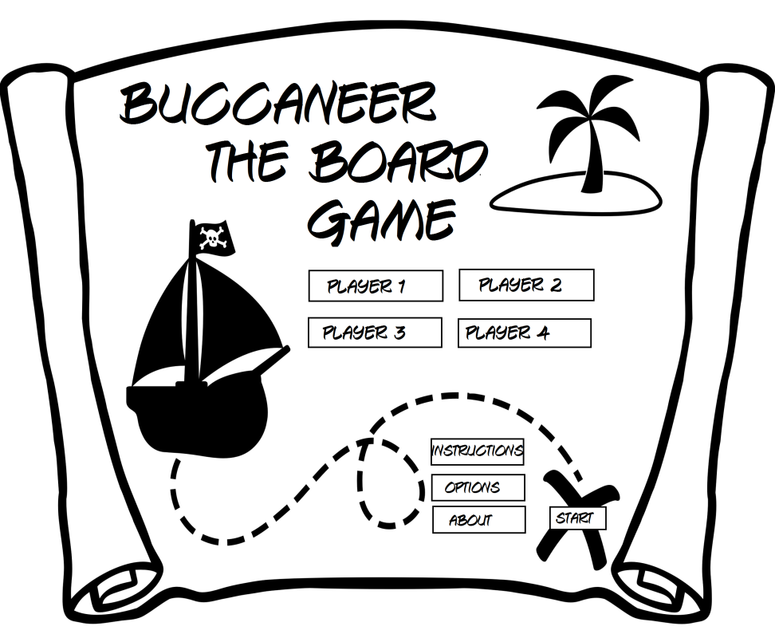
The start menu
A simple main menu that is easy to navigate and easy on the eyes.
Allows players to add 4 peoples name
The main menu has additional options like instructions. This will navigate the user to another screen teaching them how to play the game.

Slide 3
The main page
The main page will be where the users can see the board, there cards, the score and there positioning on the board.
There are multiple links on the side displaying the numbers relating to that user. This will also be a clickable option allowing them to see in more detail. An example of this would be chance cards. The main page will tell you how many you have, however if you click it will open another menu showing you your chance cards.
The main page will also mark clearly who's turn it is and give the user information about the map by scrolling over them.
This is what I think the main page will look like once complete.

Slide 4
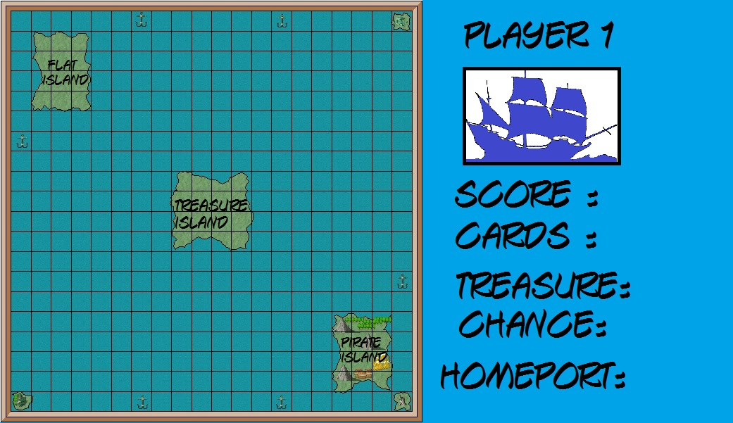
The main page

Slide 5
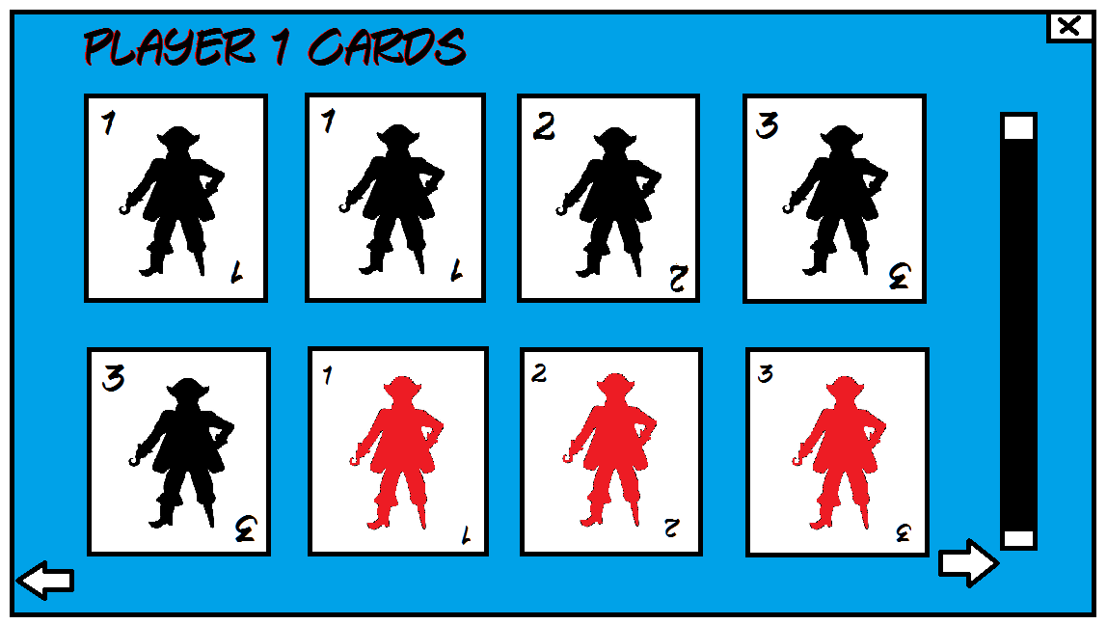
Crew cards
Once the game has started each player will be distributed a set amount of crew cards labelled 1,2 and 3 in black or red.
The picture to the side hopefully gives a good idea of what the crew menu will look like.

Slide 6
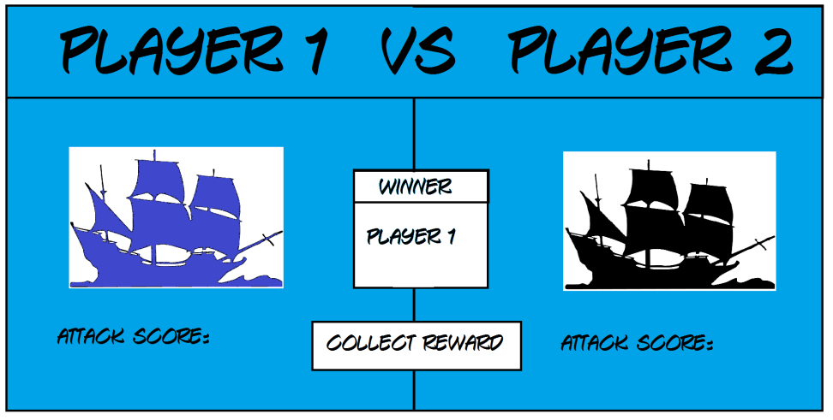
Entering battle
Once 2 boats are on the same square a battle menu will pop up. This will display the 2 players names giving the attack score, the winner and a clickable link to collect there rewards.

Slide 7
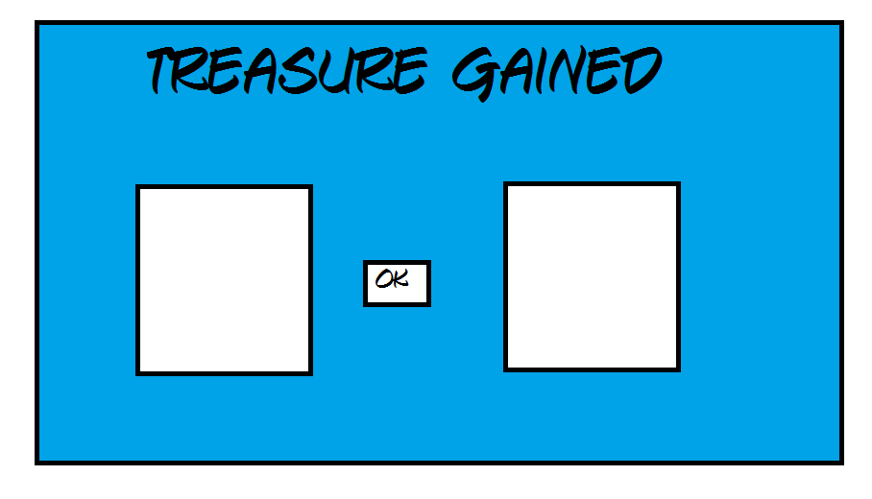
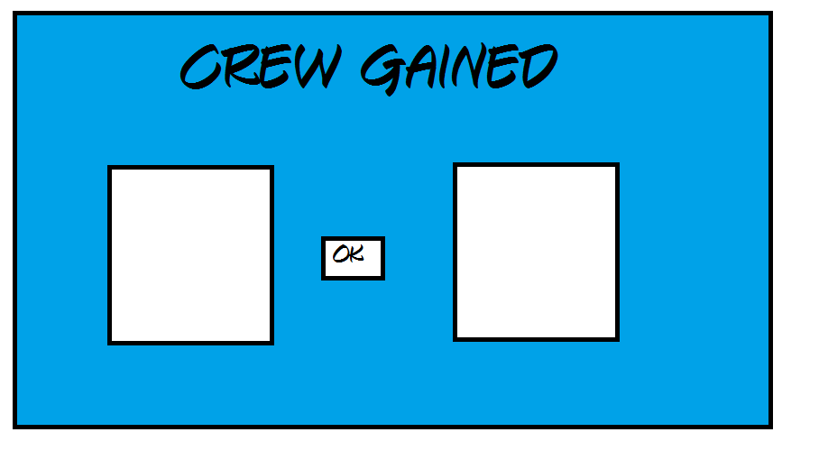
Collecting the Rewards
Once the winner of the battle has clicked the collect rewards buttons there are 2 options that the programme will sort out. The first is stealing the loser of the battles treasure. The 2 two treasures will display on the screen for the winner to click ok. The second option is gaining crew. Then the second menu will pop up showing them the up 2 two crew they have just gained.

Slide 8
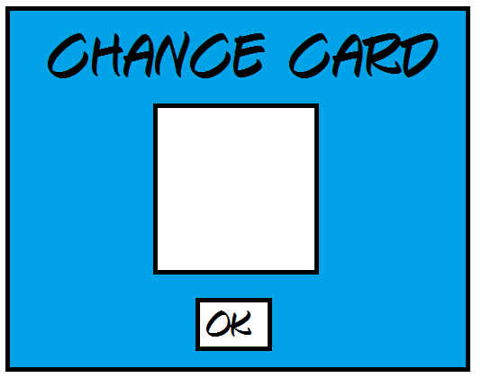
The chance cards
Once you have gained a chance card a box will pop up with the chance card displayed in the white space. The effect will either activate as soon as you have clicked ok or will be stored in your chance card inventory for later use.

Slide 9
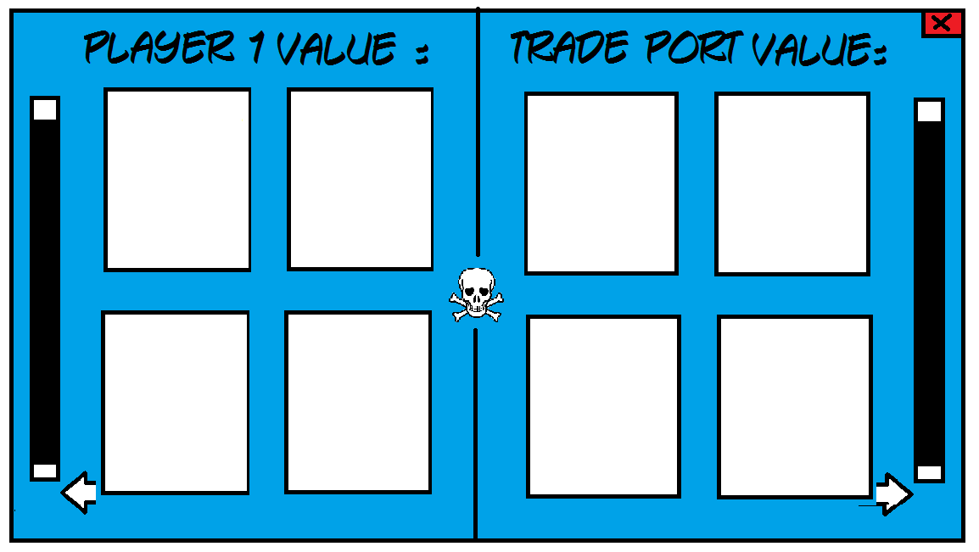
Trading
Trading at one of the ports will bring up a menu. The menu will show what is being traded for what and the values of each sides cards. Once the card values are equal the player will be able to make the trade.

Slide 10
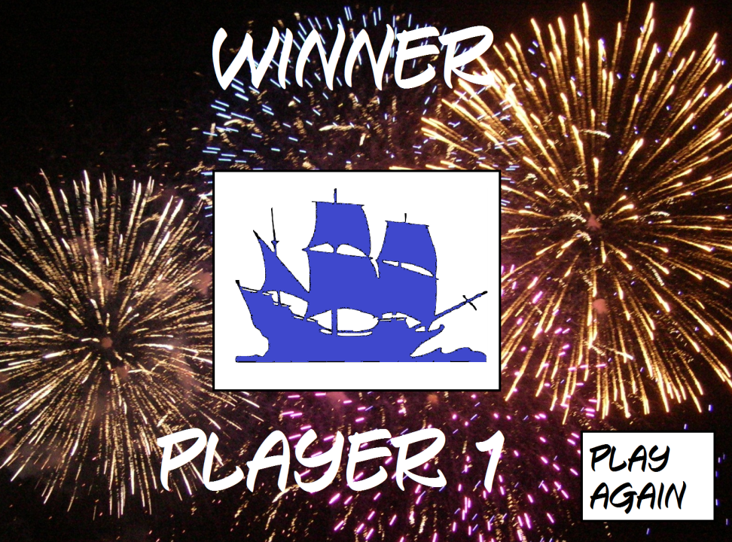
The victory screen
The victory screen appear when a player has reached all the requirements needed to win the game. Once won the victory screen will be congratulating the winner displaying the winners name and there coloured ship with fireworks in the background.
There will also be an option to play the game again meaning the game will restart.

